Slide 1
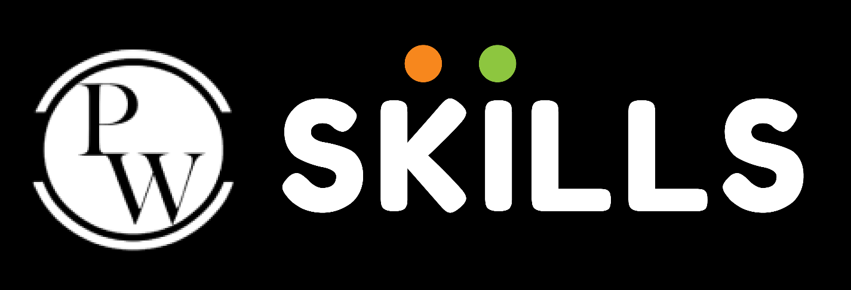

Understanding the layout and spacing

Slide 2
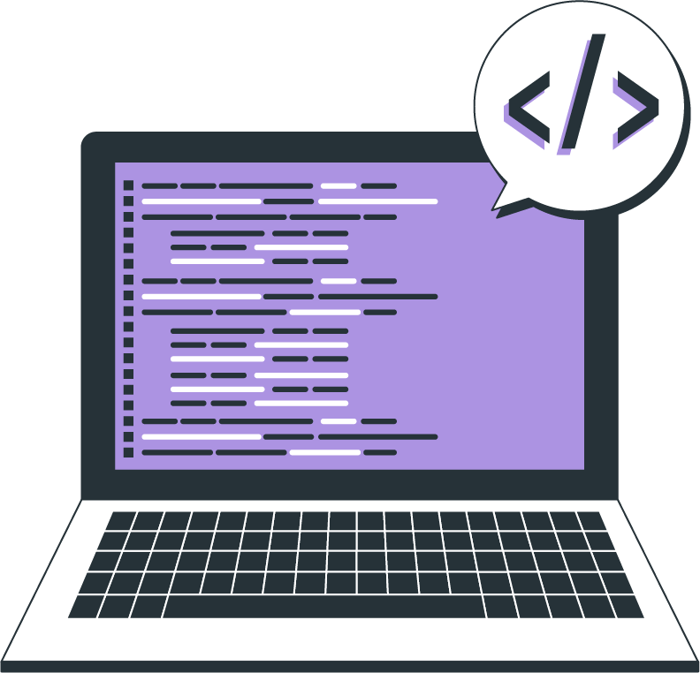
Topics
Width & height
Padding and Margins
Display Modes

Slide 3
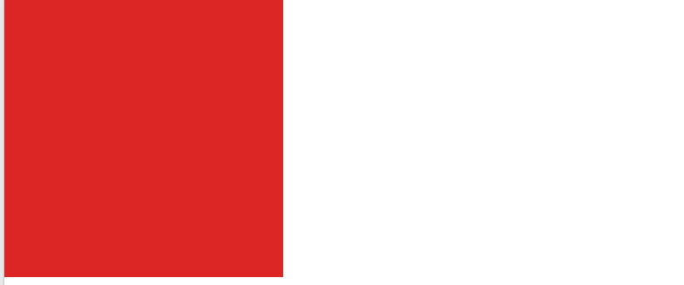
Width & Height
To apply width and height using tailwind classes, we can use w for width and h for height
Syntax
Output
// for width
.w-{size}
// for height
.h-{size}
<div class="bg-red-600 w-80 h-80"></div>

Slide 4
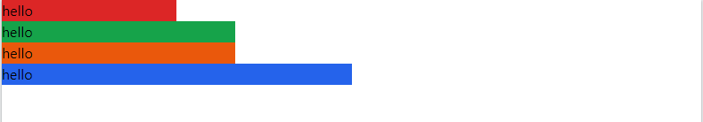
percentage width
<div class="bg-red-600 w-3/12">hello</div>
<div class="bg-green-600 w-4/12"> hello</div>
<div class="bg-orange-600 w-4/12">hello</div>
<div class="bg-blue-600 w-6/12">hello</div>
Output
w-full v/s w-screen
w-full is nothing but width:100%; in vanilla css while w-screen means width:100vw; in vanilla css

Slide 5
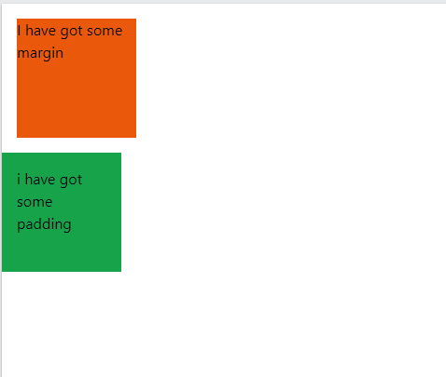
Padding and Margins
To apply padding or margin using tailwind classes, it's very easy
Syntax
Output
// for padding
.p-{size}
// for margin
.m-{size}
//padding top
.pt-{size}
//padding bottom
.pb-{size}
//padding right
.pr-{size}
//padding left
.pl-{size}
//padding on x axis
.px-{size}
// padding on y axis
.py-{size}
//margin top
.mt-{size}
//margin bottom
.mb-{size}
//margin right
.mr-{size}
//margin left
.ml-{size}
//margin on x axis
.mx-{size}
// margin on y axis
.my-{size}
<div class="bg-orange-600 w-32 h-32 m-4">I have got some margin</div>
<div class="bg-green-600 w-32 h-32 p-4"> i have got some padding</div>

Slide 6
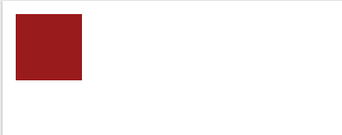
Display Modes
Lets now dive into the display modes in tailwind
Syntax
Output
.{display}
<div class='m-4 w-20 h-20 bg-red-800'></div>
<div class='m-4 w-20 h-20 bg-red-800 hidden'></div>

Slide 7
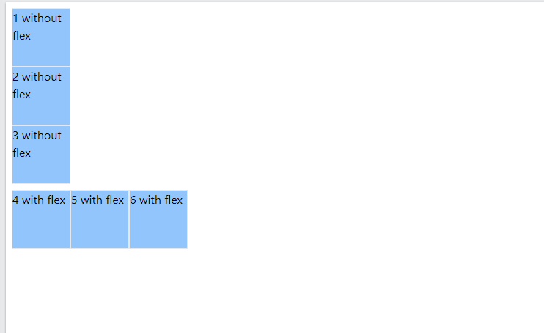
Flexbox
Flex is one of the important topics in Tailwind CSS, flexbox is tailwind is really easy to use and work with. said in the display modes topic, to apply make a div flex, we just need to add class name flex.
Syntax
Output
.flex
<div class='m-2'>
<div class='w-20 h-20 bg-blue-300 border'>1 without flex</div>
<div class='w-20 h-20 bg-blue-300 border'>2 without flex</div>
<div class='w-20 h-20 bg-blue-300 border'>3 without flex</div>
</div>
<div class='m-2 flex'>
<div class='w-20 h-20 bg-blue-300 border'>4 with flex</div>
<div class='w-20 h-20 bg-blue-300 border'>5 with flex</div>
<div class='w-20 h-20 bg-blue-300 border'>6 with flex</div>
</div>

Slide 8
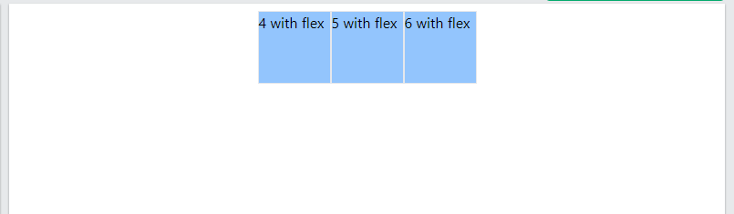
Flexbox - Justify
Now let's look how to add justify-content property of a flexbox using tailwind css
Syntax
Output
.justify-{alignment}
<div class='m-2 flex justify-center'>
<div class='w-20 h-20 bg-blue-300 border'>4 with flex</div>
<div class='w-20 h-20 bg-blue-300 border'>5 with flex</div>
<div class='w-20 h-20 bg-blue-300 border'>6 with flex</div>
</div>

Slide 9
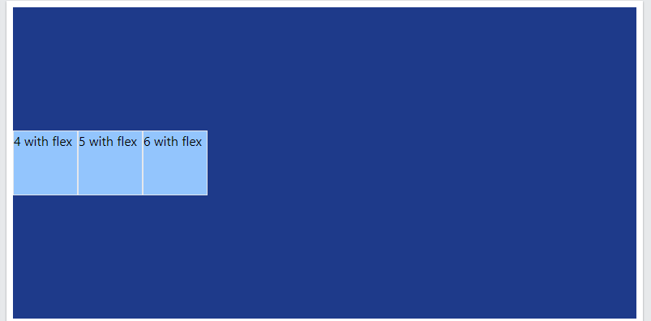
Flexbox - Align-items
Lets now see how align-items property is added to the flex box using tailwind css
Syntax
Output
.items-{alignment}
<div class='m-2 flex items-center h-96 bg-blue-900'>
<div class='w-20 h-20 bg-blue-300 border'>4 with flex</div>
<div class='w-20 h-20 bg-blue-300 border'>5 with flex</div>
<div class='w-20 h-20 bg-blue-300 border'>6 with flex</div>
</div>

Slide 10
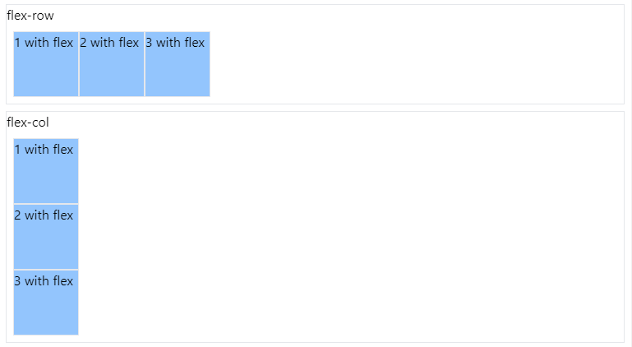
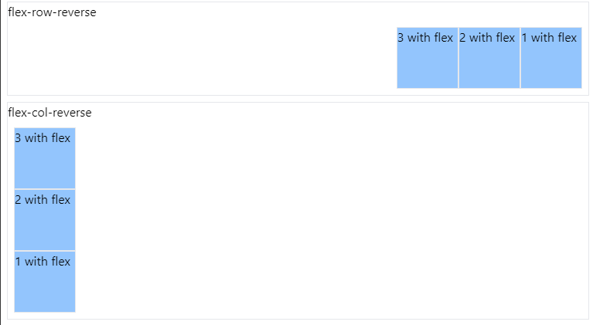
Flexbox Direction
There are predefined class names for the flexbox direction property as well
<div class="border m-2">
<div>flex-row</div>
<div class="m-2 flex flex-row">
<div class="w-20 h-20 bg-blue-300 border">1 with flex</div>
<div class="w-20 h-20 bg-blue-300 border">2 with flex</div>
<div class="w-20 h-20 bg-blue-300 border">3 with flex</div>
</div>
</div>
<div class="border m-2">
<div>flex-col</div>
<div class="m-2 flex flex-col">
<div class="w-20 h-20 bg-blue-300 border">1 with flex</div>
<div class="w-20 h-20 bg-blue-300 border">2 with flex</div>
<div class="w-20 h-20 bg-blue-300 border">3 with flex</div>
</div>
</div>
<div class="border m-2">
<div>flex-row-reverse</div>
<div class="m-2 flex flex-row-reverse">
<div class="w-20 h-20 bg-blue-300 border">1 with flex</div>
<div class="w-20 h-20 bg-blue-300 border">2 with flex</div>
<div class="w-20 h-20 bg-blue-300 border">3 with flex</div>
</div>
</div>
<div class="border m-2">
<div>flex-col-reverse</div>
<div class="m-2 flex flex-col-reverse">
<div class="w-20 h-20 bg-blue-300 border">1 with flex</div>
<div class="w-20 h-20 bg-blue-300 border">2 with flex</div>
<div class="w-20 h-20 bg-blue-300 border">3 with flex</div>
</div>
</div>
Syntax
.flex-{direction}
Output

Slide 11
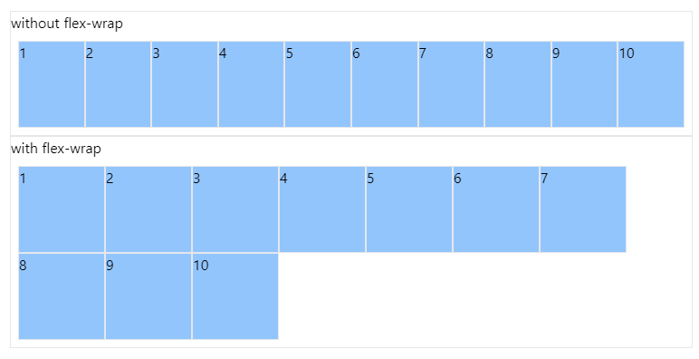
Flexbox Wrap
We can also use the flex wrap property by just adding this tailwind class
<div class="border">
<div>without flex-wrap</div>
<div class="m-2 flex">
<div class="w-24 h-24 bg-blue-300 border">1</div>
<div class="w-24 h-24 bg-blue-300 border">2</div>
<div class="w-24 h-24 bg-blue-300 border">3</div>
<div class="w-24 h-24 bg-blue-300 border">4</div>
<div class="w-24 h-24 bg-blue-300 border">5</div>
<div class="w-24 h-24 bg-blue-300 border">6</div>
<div class="w-24 h-24 bg-blue-300 border">7</div>
<div class="w-24 h-24 bg-blue-300 border">8</div>
<div class="w-24 h-24 bg-blue-300 border">9</div>
<div class="w-24 h-24 bg-blue-300 border">10</div>
</div>
</div>
<div class="border">
<div>with flex-wrap</div>
<div class="m-2 flex flex-wrap">
<div class="w-24 h-24 bg-blue-300 border">1</div>
<div class="w-24 h-24 bg-blue-300 border">2</div>
<div class="w-24 h-24 bg-blue-300 border">3</div>
<div class="w-24 h-24 bg-blue-300 border">4</div>
<div class="w-24 h-24 bg-blue-300 border">5</div>
<div class="w-24 h-24 bg-blue-300 border">6</div>
<div class="w-24 h-24 bg-blue-300 border">7</div>
<div class="w-24 h-24 bg-blue-300 border">8</div>
<div class="w-24 h-24 bg-blue-300 border">9</div>
<div class="w-24 h-24 bg-blue-300 border">10</div>
</div>
</div>
Syntax
.flex-{wrap}
Output

Slide 12
THANK YOU

